Slide 1
SARS-CoV2 Transmission Dynamics and Infection Prevention Strategies
Surbhi Leekha, MBBS, MPH

Slide 2
Outline
SARS-CoV-2 modes of transmission
Transmission to healthcare workers
Respiratory protection
Duration of viral shedding
Infection Prevention Strategies

Slide 3
Traditional Model of Transmission of Respiratory Pathogens
Dichotomy between “droplet” and “airborne
Large respiratory droplets
> 5-10 microns
Heavy and fall close to patient (within ~ 1 m)
Droplet nuclei or fine aerosols
< 5 microns
Lighter and remain suspended in air for prolonged periods and transmitted over long distances

Slide 4
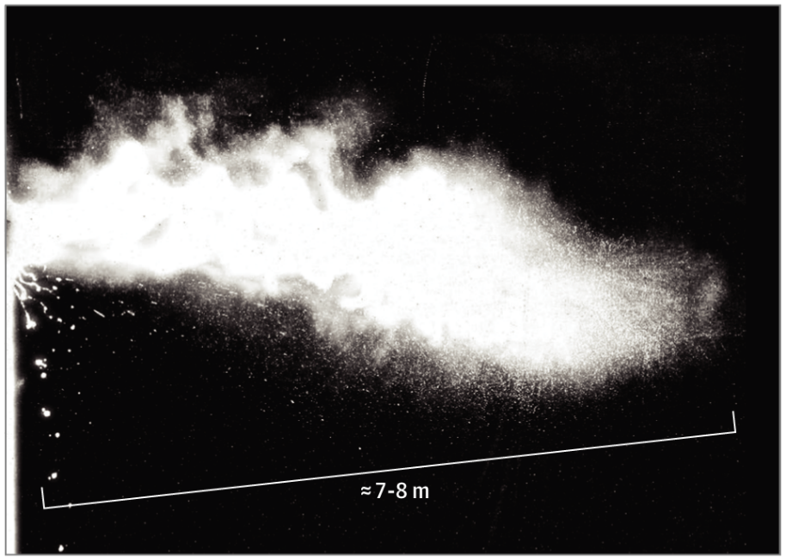
Continuum between droplet and airborne with aerosol-generating procedures or events
Large droplets close to patient
Fine aerosols land farther away
surface contamination
infection over long distances?
Bourouiba, JAMA 2020
Ian Mackay PhD. virologydownunder.com
https://i0.wp.com/virologydownunder.com/wp-content/uploads/2020/03/Particles-v12-2.png?fit=6770%2C6261&ssl=1. Accessed May 20, 2020

Slide 5
Is airborne spread a major mode of transmission for COVID-19?
SARS CoV-2 nucleic acid and viable virus (less often) found in air samples
Review attack rate and R0:
Attack rate: proportion of susceptible contacts of a case that become infected
Reproductive number (R0): average # of secondary cases from a single case
Infection | Attack rate (household) | R0
Measles | > 90% | 12-18
Varicella (chicken-pox) | 85% | 10
TB | > 50% | 10 per year
COVID-19 | 10% | 2.3
Burke MMWR 2020
Zhang Int J Infect Dis 2020
CDC Yellow Book

Slide 6
Where are the biggest outbreaks/clusters?
Meat packing
Workers in tight spaces communicate over loud machinery
Outbreaks in 115 facilities in 23 states, 5000+ workers infected
Nursing homes, prisons, behavioral health units
Congregant living
“asymptomatic spread” vs. inability to elicit or recognize symptoms
Cruise ship
Churches, synagogues, mosques
Call center
Weddings and funerals
Restaurants
Barber shops
Conferences
https://en.wikipedia.org/wiki/Impact_of_the_COVID-19_pandemic_on_the_meat_industry_in_the_United_States
Community Transmission of SARS-CoV-2 at Two Family Gatherings—Chicago, Illinois, February–March 2020. https://www.cdc.gov/mmwr/volumes/69/wr/mm6915e1.htm. Accessed May 20, 2020

Slide 7
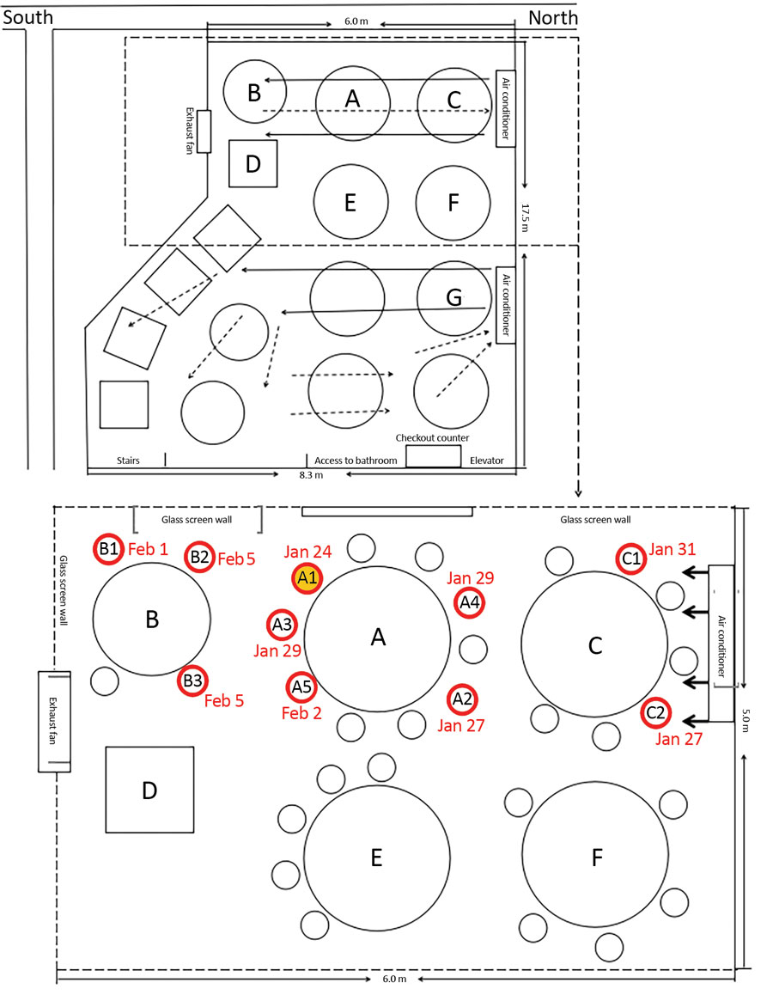
Outbreak in restaurant in Guangzhou, China
Infected index case (A1) had dinner with 9 friends
1 to 1.5 hours
Airflow was from right to left
Secondary infections occurred as follows:
~ 50% of A1’s table
~ 75% of the people on the adjacent downwind table (B) infected
2 of 7 people on the upwind table (table C) infected
No one at tables E or F became infected
Were out of the main airflow from the air conditioner on the right to the exhaust fan on the left of the room
Lu et al, MMWR. https://wwwnc.cdc.gov/eid/article/26/7/20-0764-f1

Slide 8
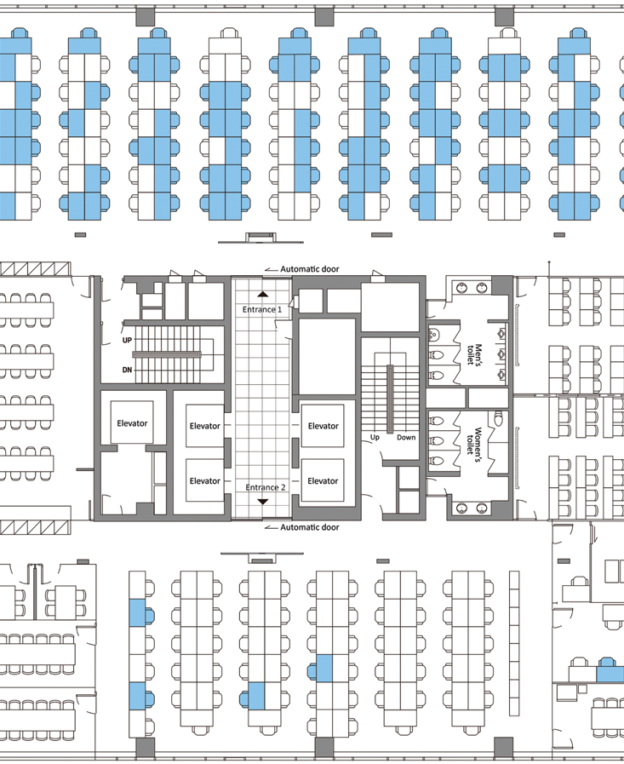
Coronavirus Disease Outbreak in Call Center, South Korea
A single infected employee on the 11th floor of call center building
Of 216 employees on 11th floor (1143 total in building), 94 became infected (44%: blue chairs, all but 2 became symptomatic)
Predominantly on one side
3 additional people on other floors of the building
Supports respiratory droplet and fomite exposure
Highlights importance of co-location in enclosed space for prolonged period
Park, Emerg Infect Dis 2020

Slide 9
Closer look into the Diamond Princess experiment
Collected daily number of 197 symptomatic cases, and of the 146 passenger cases in two categories
Those who stayed and did not stay in the same stateroom
Quarantine details and the ship's 14-day itinerary
Searched websites of national/local health authority along the cruise routes and local news for locally confirmed cases associated with the ship
Obtained the design of air conditioning and sewage treatment
Estimated dates of infection from epidemic curve and compared with the start of on-board quarantine (Feb 5)

Slide 10
Diamond Princess study
Major infections Jan 28-Feb 6 for all passengers EXCEPT those who stayed in the same stateroom with infected individual(s)
Confirmed cases among disembarked
One 80 y old passenger in Hong Kong
None in three other stopovers between Jan 27-31 associated with disembarked passengers or visitors from the ship
Two Okinawa taxi drivers who drove ship passengers
Infection among passengers after Feb 6 limited to those who stayed in the same stateroom with an infected passenger
Not for crew members
Long-range airborne route was absent in the outbreak
Most transmission through close contact and fomites
Xu, medRxiv 2020.04.09.20059113; doi: https://doi.org/10.1101/2020.04.09.20059113

Slide 12
Transmission Summary
Determinants of exposure and infection:
Quantity of virus expelled and duration of exposure
Contact with mucous membrane (direct and indirect) – droplet, contact, fine aerosols in proximity to infected individuals
Airborne over long distances unlikely
Super-spreader events
Not a characteristic of the index case
Determined by the setting: close contact in indoor spaces

Slide 13
Transmission to HCP

Slide 14
HCP infection Literature
Case report from Taiwan
41 HCP identified as having exposure to aerosol-generating procedures x at least 10 minutes < 2m from patient
intubation, extubation, noninvasive ventilation, and exposure to aerosols in an open circuit
85% wearing surgical mask, rest had N95
Type of gown not described
Serial swabs + symptom monitoring through day 14
No infections identified
Ng, Annals Intern Med 2020

Slide 15
HCP contamination Literature
Environmental contamination including PPE (Singapore NCID)
Extensive environmental contamination
No significant PPE contamination (one sample of front of shoe)
Small sample
No severely ill patients
Study of swabbing HCP (Singapore NCID)
Swabs from entire front of goggles, front surface of N95, and front surface of shoes from 30 HCWs
NOT critically ill and NOT participating in AGP
All samples negative
Ong, JAMA 2020
Ong, Infect Control Hosp Epidemiol 2020

Slide 16
HCP contamination Literature
15-bed ICU in Wuhan
Extensive environmental sampling including PPE
No details on PPE sampling relative to AGP
PPE | High pos/Low pos/Neg | Percent positive
Face shield of medical staff | 0/0/6 | 0
Sleeve cuff of medical staff | 0/1/5 | 16.7
Glove of medical staff | 0/1/3 | 25
Shoe sole of medical staff | 3/0/3 | 50
Guo, EID 2020 https://wwwnc.cdc.gov/eid/article/26/7/20-0885_article

Slide 17
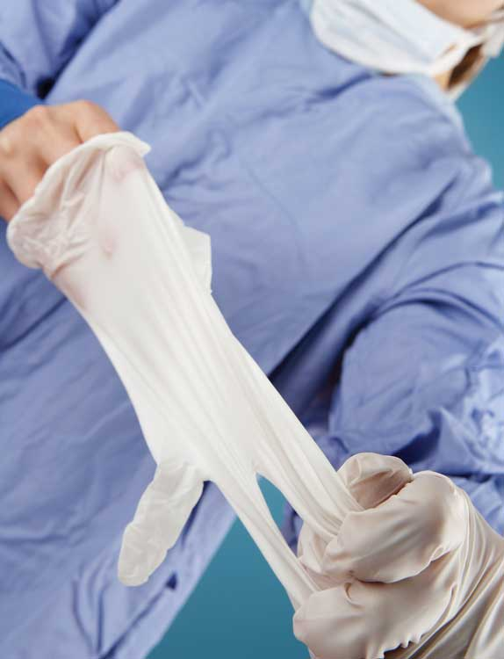
Contamination during PPE doffing
Deviations from doffing protocol associated with HCW self-contamination
Errors higher with more complex ensembles
Multiple layers of PPE
PAPR hood
Errors reduced through
Training
Observed doffing
Visual cues

Slide 18
Respiratory Protection and Use of Masks

Slide 19
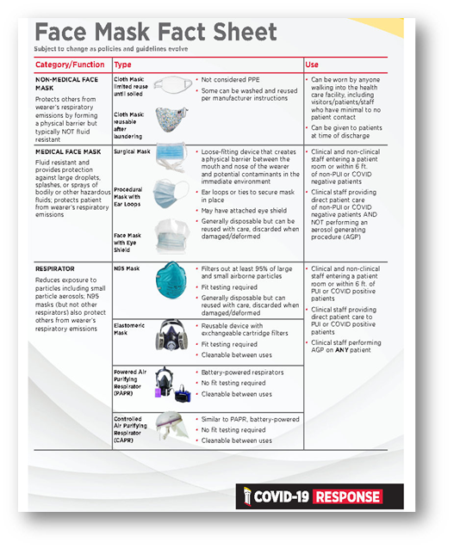
Mask Terminology and Uses
Masks used for
Source control
Protection “PPE”
Terminology
Non medical face mask or covering
Medical face mask (a.k.a “surgical” mask)
Respirator
N95
Elastomeric
Powered or controlled air-purifying respirator “PAPR” “CAPR”

Slide 20
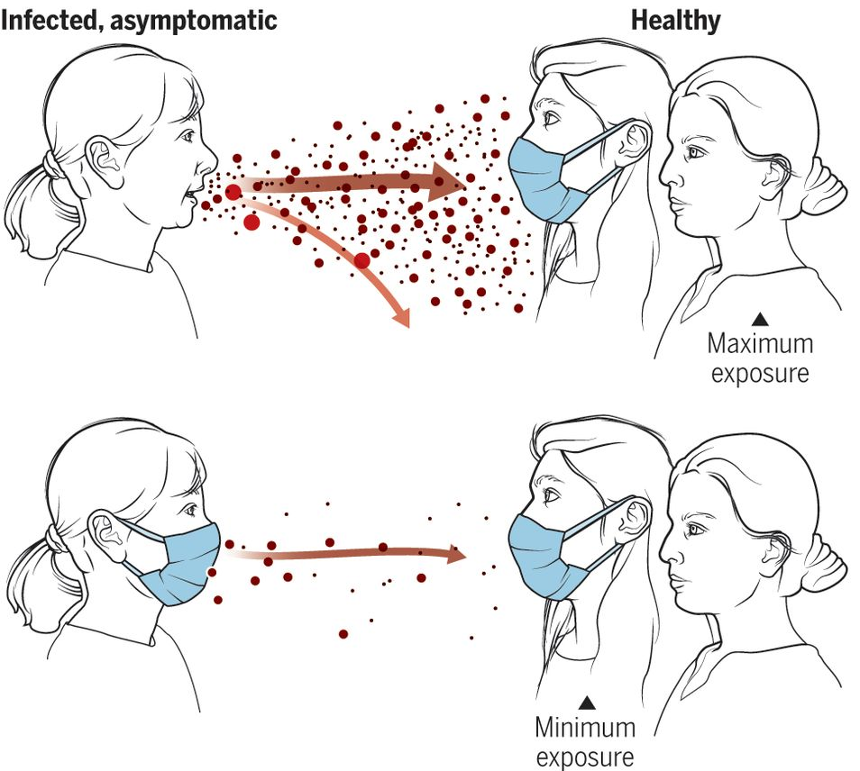
Masking for Universal Source Control
Masks/face coverings effective in protecting others from wearer’s secretions
Significantly reduce detection of influenza virus RNA in respiratory droplets and coronavirus RNA in aerosols in exhaled breath and coughs of children and adults with acute respiratory illness
Potential public health benefit if high level of compliance in community
Primarily source control, not “PPE” in this setting
Not a substitute for physical distancing
Leung, Nature Medicine 2020; Prather, Science 2020

Slide 21
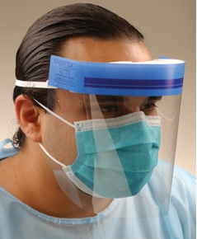
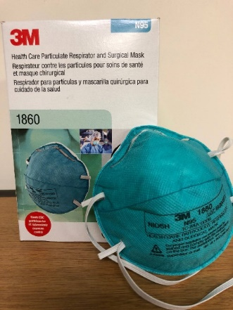
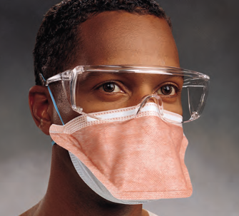
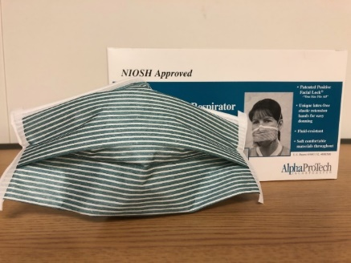
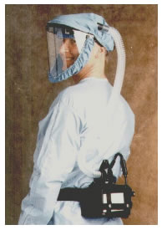
Masks as PPE: Medical face mask vs. Respirator
Medical or Surgical Mask
Barrier to protect wearer from splashes, large droplets
No seal, does not protect against fine aerosols
Addition of eye protection important
Respirator
Protects against fine aerosols
Requires proper seal (N95 and elastomeric) to ensure that air goes through filter
In vitro: N95 respirator > medical face mask in protection against influenza virus aerosols
No clinical studies clearly show benefit of respirators vs medical face mask for preventing viral respiratory infections
Bischoff, J Infect Dis 2011; Offeddu, Clin Infect Dis 2017; Radonovich, JAMA 2019

Slide 22
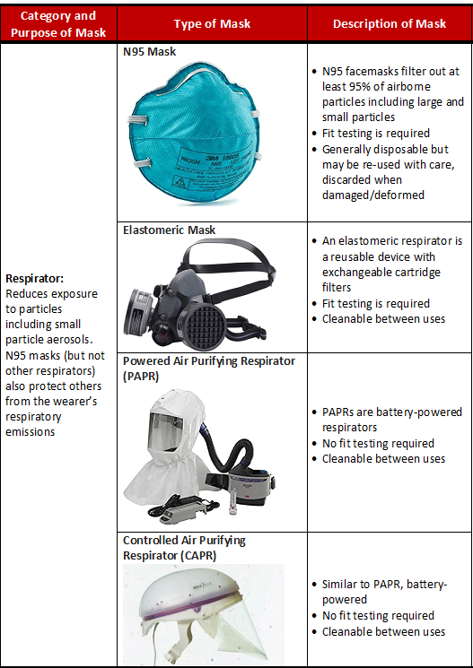
Respirator Types
All reduce exposure to fine aerosols
N95 and elastomeric require fit testing and seal
Ensures that air only enters through filters
PAPR/CAPR do not require fit-testing
Battery-powered fan pulls air through filters and circulates air throughout helmet/hood
PAPR/CAPR and elastomeric can be disinfected and re-used
N95 – traditionally disposable but can be decontaminated during shortages
UV light
Hydrogen peroxide

Slide 23
Duration of SARS-CoV-2 Viral Shedding

Slide 24
Duration of viral shedding
Variable but prolonged
Longer based on RNA (nucleic acid detection)
Shorter with viable virus (cultures)
Correlates with symptoms
Burden in upper respiratory specimens declines after onset of illness
Lower respiratory specimen positive for longer
RNA concentrations positively associated with likelihood of viable virus
Among those with detectable RNA, concentrations 3 days after recovery generally in the range at which viable virus not isolated
Not enough data among immunosuppressed individuals
No replication-competent “viable” virus after day 8-9
As live virus decreases, anti-SARS-CoV-2 antibodies increasingly detected
Seroconversion by day 7 in 50%, by day 14 in 100%
Xiao, Clin Infect Dis 2020; Lan, JAMA 2020; Yuan, Clin Infect Dis 2020
Wolfel, Nature 2020; CDC unpublished data

Slide 25
Viral shedding and infectiousness: lessons from contact tracing
Repeat positives after testing negative
Positive RT-PCR tests for SARS-CoV-2 in patients following clinical improvement and negative results on two consecutive tests
occurred shortly after the negative tests
not associated with worsening symptoms
likely did not reflect reinfection
Korean study of “repeat positive cases”
Cases with positive viral RNA after being “discharged from isolation”
Investigated 285 (64%) of total 447 re-positive cases (as of 15 May)
Virus not isolated in cell culture
A total of 790 contacts (of the 285 cases) were identified (351=family; 439=others).
From the monitoring of contacts, no case that was newly confirmed from exposure during repeat-positive period alone
KCDC. https://www.cdc.go.kr/board/board.es?mid=a30402000000&bid=0030

Slide 26
Summary: Guiding Principles for Infection Prevention Practice during COVID-19
Close contact with large droplets from infected individual
Potential role of fine aerosols created in close proximity to infected individual
Extensive surface contamination around infected patient in hospital setting
Entry through mucous membranes
Airborne transmission over long distances unlikely
Individuals can be infected and asymptomatic or pre-symptomatic (i.e., shedding 1-2 days prior to symptom onset)
Prolonged viral RNA shedding ~ 4-6 weeks
Viable virus recovery in cultures correlates with symptoms, not recovered past 9 days from symptom onset
Lack of secondary cases from those with prolonged shedding

Slide 27
Infection Prevention Strategies

Slide 28
Key policies and practices based on guiding principles
PPE
Universal masking
Expanded PPE – all patients, COVID-19 patients
Evaluation of patients with COVID-19 symptoms “Persons Under Investigation (PUI)”
Management of patients confirmed to have COVID-19
Duration of isolation precautions
Expanded testing for COVID-19 among asymptomatic patients
Safety among colleagues

Slide 29
Expanded PPE and Universal Masking Policy
Basic
Anyone in facility, without patient contact
Face mask or covering
Elevated
Anyone in contact with non-COVID-19 patient or suspect and not performing aerosol-generating procedures
Face mask plus eye protection (hand hygiene/gloves under standard precautions
High
Anyone in contact with COVID-19 patient or suspect or performing aerosol-generating procedures on any patient
Respirator plus eye protection, gloves and gown

Slide 30
COVID-19 Precautions Terminology
AIRBORNE DROPLET & CONTACT PRECAUTIONS
ENHANCED DROPLET & CONTACT PRECAUTIONS
STANDARD “ELEVATED” PRECAUTIONS
Respirator (N-95, Elastomeric or PAPR)
Face shield
Gloves
Gowns
Keep door closed
Negative Pressure Room
Respirator (N-95, Elastomeric or PAPR)
Face shield
Gloves
Gowns
Keep door closed
Standard Room
Surgical Mask
Face shield
Gloves*
Gown*
*As dictated by Standard Precautions e.g., when anticipating close contact with bodily fluid
Standard Room

Slide 31
Breaking down “airborne” precautions
Respirator
Protects person close to patient inside room
Negative pressure/direct external exhaust
Protects those outside the room not in PPE
Prioritized for patients at high risk of aerosol-generating procedures e.g., intubation, extubation, positive pressure ventilation, bronchoscopy
Keep door closed

Slide 32
Approach to Isolation Precautions for Persons Under Investigation (PUI)
Wide spectrum of illness and symptoms associated with COVID-19
Maintain low threshold to consider a patient COVID-19 PUI
Place patient in COVID-19 precautions
Airborne, droplet, and contact or
Enhanced droplet and contact
“Full” PPE including gown, gloves, respirator and eye protection, difference between airborne and enhanced is negative pressure room
Prioritize airborne/negative pressure room for patients requiring aerosol generating procedures

Slide 33
Acting on test results for PUIs
Patient tests positive: move to dedicated COVID unit/patient area when possible
Patient with initial negative test
High clinical suspicion for COVID-19?
Alternate diagnosis?
Consider ID consult to guide evaluation
Obtain lower respiratory sample whenever possible (sent to MDH)
Maintain PUI status while clinical suspicion remains and no other diagnosis

Slide 34
Management of confirmed COVID-19 patients
Cohorted in dedicated geographic patient area
Reduce staff and patient exposure to SARS-CoV2
Staff move between patients in same PPE
Hand hygiene and glove changes between patients
Reduce doffing opportunities and chance of self-contamination during doffing
Dedicated observer for PPE doffing at exit
Conserve PPE
Use of tele-monitoring
Minimize close patient contact

Slide 35
Duration of isolation precautions
Follow CDC “test-based” strategy
Start testing at least 1 week from initial test AND improvement for 72 h
When two consecutive tests at least 24 h apart negative, patient considered “COVID-19 Recovered”
Patients can be moved out of dedicated COVID-19 patient area/COVID-19 precautions
Continue droplet and contact precautions (medical face mask, eye protection plus gloves and gowns) for duration of hospital stay
Accounts for uncertainty of prolonged viral shedding, particularly in critically ill and immunosuppressed patients

Slide 36
Enhancing Safety Among Patients: Universal Testing
Why test asymptomatic patients?
Some patients with COVID-19 may be asymptomatic or have atypical symptoms
Patients may begin shedding virus 1-2 days prior to the onset of symptoms
Who should undergo asymptomatic COVID-19 screening?
All hospitalized patients regardless of symptoms, at admission
Within 48-96 h before surgery
Laboring mothers prior to delivery/C-section
Expanding to outpatient: prior to starting chemotherapy, practices with frequent aerosol procedures (ENT, dental, lung function, sleep lab etc.)

Slide 37
Universal Testing and Infection Prevention
Asymptomatic patients do not need to be considered PUIs
UMMS “Standard precautions” presume that any patient could be infected
Use Standard Precautions in accordance with the UMMS Expanded Use of PPE Guidance i.e., mask and eye protection pending test results.
Appropriate PPE (i.e., respirator, eye protection, gowns, and gloves) should be worn during nasopharyngeal swab collection due to the potential for aerosol generation
The patient should wear a mask for source control while test is pending

Slide 38
Enhancing Safety when interacting with colleagues
Safety measures while amongst colleagues
Social Distancing
Universal masking
Hand hygiene
Temperature/symptom screening and not coming to work when sick
*High-risk activities*
Breaks and meals
Activities that require talking for prolonged periods in close quarters: hand-off/signout, sitting close and talking at workstations, rounds
Doffing PPE together

Slide 39
Resources
UMMS COVID-19 response website
Clinical Practice Guidelines (Infection Prevention Chapter)
Questions?

